Slide 1

A Hybrid Methodology for Inventory Classification with the Application of Machine Learning Algorithms
A thesis submitted in partial fulfillment of the requirements for the degree Of
BACHELOR OF SCIENCE IN INDUSTRIAL & PRODUCTION ENGINEERING
Anik Roy
201736002
Ashiqur Rahman Khan
201736004
MD. Fahim Montasir
201736022
Under the guidance of
Dr. Kais Bin Zaman
Professor, Department of IPE, BUET
Department of Industrial and Production Engineering
Military Institute of Science and Technology (MIST)
Mirpur Cantonment, Mirpur, Dhaka-1216

Slide 2

Responsibilities of Industrial Engineer
Reduce Waste
Boost Profit
Minimize Cost
Minimize Production and Inventory Time
Solving Process Issues
Maximize Process Efficiency
Optimize Production Process

Slide 3
SUPPLY CHAIN MANAGEMENT
”Supply chain strategies require a total systems view of the links in the chain that work together efficiently to create customer satisfaction at the end point of delivery to the consumer. As a consequence, costs must be lowered throughout the chain by driving out unnecessary expenses, movements, and handling. Efficiency must be increased, and bottlenecks removed. The supply-chain system must be responsive to customer requirements.”
-By Tony Hines

Slide 4
Drivers of SUPPLY CHAIN MANAGEMENT
Facilities
Inventory
Cross-Functional Drivers
Information
Sourcing
Logistical Drivers
Transportation
Pricing

Slide 5
Why Inventory?

Slide 6
Objectives of Inventory Management
-To ensure a continuous supply of materials and stock so that production should not suffer at the time of customers demand,
-To avoid both overstocking and under-stocking of inventory,
-To maintain a systematic record of inventory,
-To facilitate furnishing of data for short and long-term planning with a controlled inventory.
-To optimize various costs indulged with inventories like purchase cost, carrying cost, storage cost,
-To ensure the quality of goods at reasonable prices,

Slide 7
Our Focus
Inventory Item Classification
Cost
Minimizes Inventory Cost that associates reducing Production Cost
Time
Reduces Material Handling Time, Order Placement Time, and Inventory Time.

Slide 8
Thesis Topic
“A HYBRID METHODOLOGY FOR INVENTORY CLASSIFICATION WITH THE APPLICATION OF MACHINE LEARNING ALGORITHMS”

Slide 9

Classification Process
ABC Analysis
MCDM Models
ML Models
Inventory Item Classification

Slide 10

ABC Analysis Process
ABC Analysis basically classifies inventory items based on the annual consumption value (ACV) of the items. This analysis is done by 80/20 distribution or Pareto Principle.
'A' items – 20% of the items accounts for 70% of the ACV of items
'B' items – 30% of the items accounts for 25% of the ACV of items
'C' items – 50% of the items accounts for 5% of the ACV of items
Conventional ABC Analysis only accounts for Annual Consumption Value(ACV) of each item. But there are other major criteria which may effect the inventory classification.

Slide 11
Statistical Model Process
Multiple-Criteria Decision-Making (MCDM)
This method explicitly evaluates multiple conflicting criteria in decision making.
Multiple-Criteria
Raw Data Set
Conflicting Criteria
One New Criterion
Utilizing different MCDM methods
Weighted Scores
Reordering the Data Set
Considering the newly generated criterion
Ascending order or Descending order
ABC Analysis
Considering Beneficial and Non-beneficial Attributes
Following Pareto Principle
Done for different MCDM methods
For existing Inventory-items.
Here, MCDM method is used for Classification purpose.

Slide 12
Multiple-Criteria Decision-Making (MCDM)
There are several MCDM methods available. Such as-
Analytical Hierarchy Process(AHP)
Analytic Network Process (ANP)
Best Worst Method (BWM)
Simple Multi-Attribute Rating Technique (SMART)
Stratified Multi Criteria Decision Making (SMCDM)
Simple Additive Weight (SAW)
Weighted product model (WPM)
Weighted sum model (WSM)
VIKOR method
Technique for the Order of Prioritization by Similarity to Ideal Solution (TOPSIS)
After analyzing various research paper and implementation processes, following three MCDM method were selected for ABC Classification purpose-
Analytical Hierarchy Process(AHP)
Simple Additive Weight (SAW)
VIKOR method

Slide 13

What about the Newly added items to the inventory?
Should the whole previous activities be repeated for classifying the newly added item?
Reasons Behind this-
Time Consuming
Less Efficient
Malfunctioning
Re-classification of existing items
Confused Classification

Slide 14

What would be done to solve this issue?
Machine Learning Algorithms can be implemented to solve this issue.
Data about the newly added item to the inventory
Trained with existing item- classification Machine Learning Model
Predicted Class for New Inventory Items

Slide 15
Machine Learning Model
Support Vector Machining (SVM)
Artificial Neural Network (ANN)
Unsupervised Learning
K-means
AdaBoost
Supervised Learning
K-Nearest Neighbors (KNN)
Apriori algorithm
Gaussian Process Classifier (GPC)
Principal Component Analysis (PCA)
Here, Supervised Machine Learning Algorithms are used that the class can be predicted precisely for newly added inventory item with the help of previously predicted data classes.

Slide 16
History on Hybrid Methodology for Multi-Attribute Inventory Analysis
Machine Learning Algorithms
MCDM Methods
Hybrid Methodology
10 June 2016, Hasan Kartal et al published “An integrated decision analytic framework of machine learning with multi-criteria decision making for multi-attribute inventory classification”
Inventory Classification
ABC Analysis
MCDM Methods
SAW
Machine Learning Algorithms
ANN
AHP
VIKOR
SVM,
Naïve Bayes,
Bayesian network

Slide 17
History on Hybrid Methodology for Multi-Attribute Inventory Analysis
Kartal et al,
Support Vector Machines for Multi-Attribute ABC Analysis
SVM is highly applicable in the inventory settings
Ramanathan et al,
A weighted linear optimization for inventory classification
ABC inventory classification with multiple-criteria using weighted linear optimization
Davood Sabaei et al,
A review of multi-criteria decision making methods for enhanced maintenance delivery
MCDM techniques, comparison analysis among different MCDM methods
Chung-Hsing et al,
A problem-based selection of multi-attribute decision-making methods
Different datasets may result in different classes for a particular inventory
Ali Jahan et al,
A comprehensive VIKOR method for material selection
Methodology on updated VIKOR method with different examples

Slide 18

Our Proposed Model

Slide 19
Selection of MCDM Models
SAW
Basic and mostly used MCDM model to evaluate any multi-attributes inventory analysis
Works with maximum and minimum value of a particular attribute
AHP
Comparative analysis among the attributes
Consistency of the attributes
VIKOR
Optimized MCDM model
A compromised solution based on the mutual concessions

Slide 20
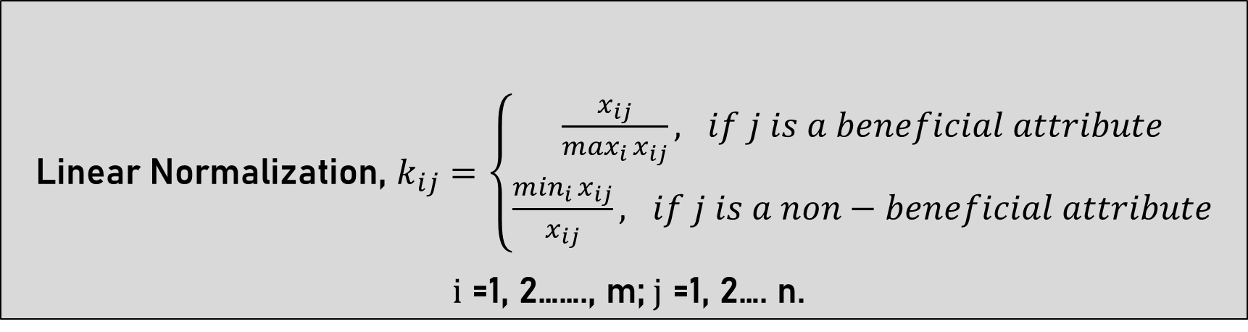
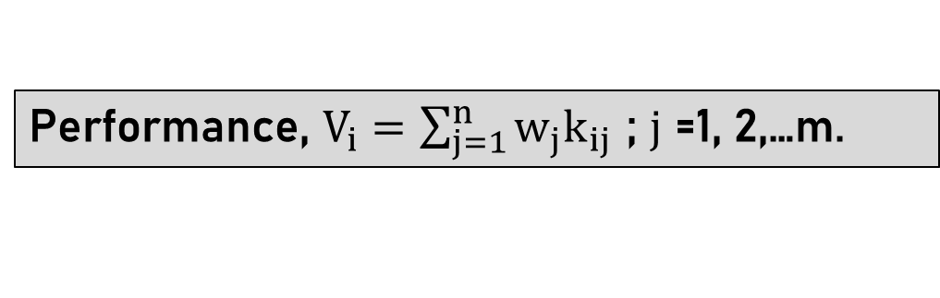
Simple Additive Weight (SAW)
Linear Normalization, $k_{ij}=\left\{\begin{aligned}\frac{x_{ij}}{\max_{i }x_{ij}}, if j is a beneficial attribute \\ \frac{\min_{i }x_{ij}}{x_{ij}}, if j is a non−beneficial attribute\end{aligned}\right.$
$i$ =1, 2……., m;$j$ =1, 2…. n.
Performance, $V_{i}=\sum_{j=1}^{n}{w_{j}k_{ij }}$; $j$ =1, 2,…m.

Slide 21
Analytical Hierarchy Process(AHP)
Saaty's Scale for AHP
Rank | Description
1.00 | Equally Important
3.00 | Moderately Important
5.00 | Strongly Important
7.00 | Significantly Important
9.00 | Extremely Important
Pair-Wise Matrix by AHP
 | mfg | sell | demand | fcost | rma
mfg | 1 | 1/7 | 1/5 | 2 | 1/3
sell | 7 | 1 | 2 | 9 | 3
demand | 5 | 1/2 | 1 | 7 | 3
fcost | 1/2 | 1/9 | 1/7 | 1 | 1/5
rma | 3 | 1/3 | 1/3 | 5 | 1

Slide 22
Analytical Hierarchy Process(AHP)
Criteria Weight Determination by AHP
 | mfg | sell | demand | fcost | rma | criteria_weight
mfg | 0.060606 | 0.068519 | 0.054407 | 0.083333 | 0.044205 | 0.062214
sell | 0.424242 | 0.479157 | 0.544070 | 0.375000 | 0.398248 | 0.444143
demand | 0.303030 | 0.239578 | 0.272035 | 0.291667 | 0.398248 | 0.300912
fcost | 0.030303 | 0.053186 | 0.038901 | 0.041667 | 0.026550 | 0.038121
rma | 0.181818 | 0.159559 | 0.090588 | 0.208333 | 0.132749 | 0.154610

Slide 23


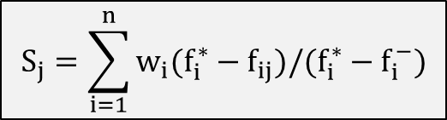
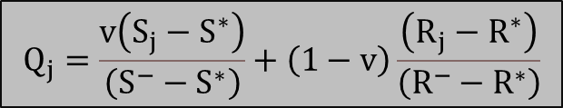
VIšekriterijumsko KOmpromisno Rangiranje (VIKOR)
$$w_{j}=\sum_{i=1}^{n}{w_{i}f_{ij }}$$
Where,
f_(ij ) = value of jth alternative and ith criterion
w_i = weight of ith criterion
$$S_{j}=\sum_{i=1}^{n}{w_{i}(f_{i}^{∗}−f_{ij})/(f_{i}^{∗}−f_{i}^{−})}$$
$$R_{j}=\max_{i}[w_{j}(f_{i}^{∗}−f_{ij})/(f_{i}^{∗}−f_{i}^{−})]$$
$$Q_{j}=\frac{v\left(S_{j}−S^{∗}\right)}{\left(S^{−}−S^{∗}\right)}+\left(1−v\right)\frac{\left(R_{j}−R^{∗}\right)}{\left(R^{−}−R^{∗}\right)}$$

Slide 24
Selection of ML Algorithms
ANN
Works well with non-linear data
GPC
Higher accuracy with higher training time
KNN
Comparatively Higher accuracy with lower training time
SVM
Mostly used on classification models

Slide 25

ARTIFICIAL NEURAL NETWORK
Supervised Machine Learning Method
Three Components
Input
Output
Transfer Function
Takes extraordinary values and weights
Calculated for the known class
Translates the input signals to output signals

Slide 26
ARTIFICIAL NEURAL NETWORK
ReLU
mfg
Softmax
ReLU
A
fcost
sell
B
demand
C
rma
Input
Layer
Hiden
Layer
Output
Layer

Slide 27
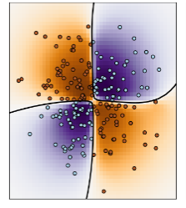
GAUSSIAN PROCESS CLASSIFICATION
Nonparametric classification method
Assumes some prior distribution on the underlying probability densities
Confidence Interval can be developed from the probability densities

Slide 28
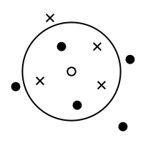
K-Nearest Neighbor
A simple, supervised machine learning algorithm
Solve both classification and regression problems
Class A
Class B
Class C

Slide 29
K-Nearest Neighbor
Calculate the distance between test data and each row of training data
Sort the calculated distances in ascending order based on distance values
Get top k rows from the sorted array
Get the most frequent class of these rows
Return the predicted class

Slide 30
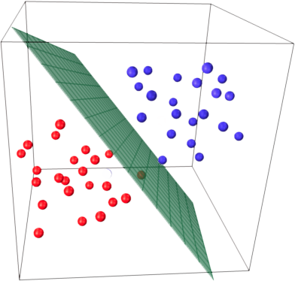
SUPPORT VECTOR MACHINE
Deals with two class or multi class classification
Maintains a maximum margin strategy that transformed into solving a complex quadratic programming problem
Classifies data by finding the best hyper plane that separates all data points

Slide 31
SUPPORT VECTOR MACHINE
Maximum-margin hyper plane and margins for an SVM trained with samples from two classes
Best Margin
C1
C2
Dividing hyperplane

Slide 32
Additional Approach to This Research
Newly Implemented Machine Learning Models for Inventory Item Classification:
Gaussian Process Classifier (GPC)
K-Nearest Neighbors (KNN)

Slide 33
Additional Approach to This Research
“Voting System” for Inventory Item Classification:
Combines all MCDM method results into one.
Gives a Conclusive Classification for existing inventory items.

Slide 34
Methodology
Inventory Item Dataset
Selecting Features Based on Strong Relationship with Item Properties
MCDM Methods: AHP, SAW & VIKOR
Training the ML Models by the selected Features and the A, B & C Classes
ABC Analysis Based on MCDM Outcomes
ML Algorithms: ANN, GPC, KNN & SVM
Generating A, B & C Classes
Predict A, B & C Classes
Combining Three Sets of MCDM Based ABC Classes into One by VOTING System
Evaluate the classification accuracies
Higher performance ML Model with corresponding MCDM Model

Slide 35
Discussion on Voting System
Item_Number | AHP_Class | SAW_Class | VIKOR_Class | Combo_Class
1 | C | C | C | C
2 | B | A | A | A
3 | A | A | A | A
4 | A | A | A | A
5 | C | B | A | B
For Item_Number 2:
1. AHP based ABC Classes (AHP_Class)
2. SAW based ABC Classes (SAW_Class)
3. VIKOR based ABC Classes (VIKOR_Class)
AHP_Class
B
SAW_Class
A
VIKOR_Class
A
Combo_Class
A

Slide 36
Discussion on Voting System
Item_Number | AHP_Class | SAW_Class | VIKOR_Class | Combo_Class
1 | C | C | C | C
2 | B | A | A | A
3 | A | A | A | A
4 | A | A | A | A
5 | C | B | A | B
For Item_Number 5:
AHP_Class
C
SAW_Class
B
VIKOR_Class
A
Combo_Class
B

Slide 37
Discussion on Voting System
AHP 150K | train_Acc | test_Acc | time | performance
ANN | 99.8 | 99.8 | 24.99 | 0.991
SVM | 77.94 | 77.83 | 278.32 | 0.043
KNN | 87.38 | 75.67 | 0.18 | 0.392
GPC | 100 | 74.49 | 301.35 | 0.633
AHP 100K | train_Acc | test_Acc | time | performance
ANN | 99.73 | 99.73 | 16.34 | 0.982
SVM | 77.85 | 77.83 | 116.98 | 0.045
KNN | 87.07 | 75.03 | 0.11 | 0.381
GPC | 100 | 73.5 | 103.53 | 0.654
ANN
Avg train, test accuracy
Avg run time
1.ANN,
5 times
SAW 150K | train_Acc | test_Acc | time | performance
ANN | 99.79 | 99.79 | 23.46 | 0.995
SVM | 64.74 | 64.95 | 566.32 | 0.027
KNN | 80.82 | 63.94 | 0.18 | 0.443
GPC | 100 | 63.03 | 308.44 | 0.592
SVM
Avg train, test accuracy
Avg run time
SAW 100K | train_Acc | test_Acc | time | performance
ANN | 99.77 | 99.77 | 16.47 | 0.984
SVM | 64.6 | 65.1 | 219.86 | 0.027
KNN | 80.4 | 63.21 | 0.11 | 0.436
GPC | 100 | 62.32 | 100.7 | 0.615
1.AHP,
2.SAW,
3.VIKOR,
4.Combo
2.SVM,
5 times
3.KNN,
5 times
KNN
Avg train, test accuracy
Avg run time
VIKOR150K | train_Acc | test_Acc | time | performance
ANN | 98.26 | 98.26 | 13.56 | 0.925
GPC | 100 | 73.42 | 113.49 | 0.701
SVM | 91.93 | 92.04 | 117.51 | 0.335
KNN | 88.07 | 77.2 | 0.11 | 0
VIKOR100K | train_Acc | test_Acc | time | performance
ANN | 98.89 | 98.89 | 36.14 | 0.980
GPC | 100 | 76.05 | 314.4 | 0.821
KNN | 88.37 | 77.73 | 0.54 | 0.513
SVM | 75.6 | 75.57 | 784.86 | 0
4.GPC,
5 times
GPC
Avg train, test accuracy
Avg run time
COMBO 150K (SAW) | train_Acc | test_Acc | time | performance
ANN | 99 | 99 | 20.45 | 0.97
SVM | 77 | 77 | 406.12 | 0.01
KNN | 87 | 76 | 0.16 | 0.42
GPC | 100 | 77 | 325.12 | 0.55
COMBO 100K (SAW) | train_Acc | test_Acc | time | performance
ANN | 98 | 98 | 18.61 | 0.94
SVM | 77 | 78 | 206.14 | 0.04
KNN | 87 | 76 | 0.11 | 0.43
GPC | 100 | 75 | 121.67 | 0.58

Slide 38
Data Description
Data Source- Randomly generated dummy data
Features of Dataset
Features | Data Type | Features Category
Manufacturing Cost | int64 | Non-beneficial
Fixed Cost | float64 | Non-beneficial
Selling Price | float64 | Beneficial
Demand per Week | int64 | Beneficial
Raw Material Availability | int64 | Beneficial

Slide 39
Data Description
1.Manufacturing Cost per Product:
Manufacturing Cost = np.random.randint(50,500, n)
Where, n = number of items
2.Fixed Cost per Product:
Fixed Cost = (manufacturing cost / 2) + (20% of manufacturing cost)
3.Selling Price:
Selling Price = (manufacturing cost + fixed cost) + (manufacturing cost + fixed cost) / 2
4.Demand per week:
Demand per Week = np.random.randint(1500, 7000, n)
5.Raw Material Availability:
Raw material availability of a product is a categorical data

Slide 40

RESULT
Machine Specifications:
Machine Name: Virtual Machine powered by Kaggle
Processor: 4 Core
Clock speed : 2.2 GHz
Ram: 16 GB

Slide 41
RESULT
Overall Performance Measure by SAW for Dataset 01
Dataset 01 (100k) | MCDM | ML | TRAIN ACCURACY | RUN TIME | INDIVIDUAL PERFORMANCE | Performance By SAW
0 | VIKOR (100K) | ANN | 98.26 | 13.56 | 0.980 | 0.989
1 | AHP (100K) | ANN | 99.73 | 16.34 | 0.982 | 0.957
2 | SAW (100K) | ANN | 99.77 | 16.47 | 0.984 | 0.956
3 | Combo (100k) (SAW) | ANN | 98 | 18.61 | 0.944 | 0.919

Slide 42
RESULT
Performance Value Vs MCDM Models for Dataset 01

Slide 43
RESULT
Overall Performance Measure by SAW for Dataset 02
Dataset 02 (150k) | MCDM | ML | TRAIN ACCURACY | RUN TIME | INDIVIDUAL PERFORMANCE | Performance By SAW
0 | Combo (150k) (SAW) | ANN | 99 | 20.45 | 0.973 | 0.994
1 | SAW (150k) | ANN | 99.79 | 23.46 | 0.995 | 0.968
2 | AHP (150K) | ANN | 99.8 | 24.99 | 0.991 | 0.955
3 | VIKOR (150K) | ANN | 98.89 | 36.14 | 0.925 | 0.885

Slide 44
RESULT
Performance Value Vs MCDM Models for Dataset 02

Slide 45
Conclusion
1. Artificial Neural Network (ANN) is found the most balanced machine learning algorithm among the four ML algorithms.
2. VIšekriterijumsko KOmpromisno Rangiranje (VIKOR) is found the highest performing MCDM model for small dimensional dataset.
3. Combination of SAW, AHP and VIKOR shows better performance than individual MCDM models for larger dimensional dataset.

Slide 46
FUTURE WORK
Better research can be done
More accurate ML algorithms can be introduced in future
Different MCDM methods can be applied
Real-life data may be available to the researchers

Slide 47


